Slide 1
Concordia-McGill RDE

Slide 2
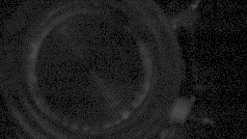
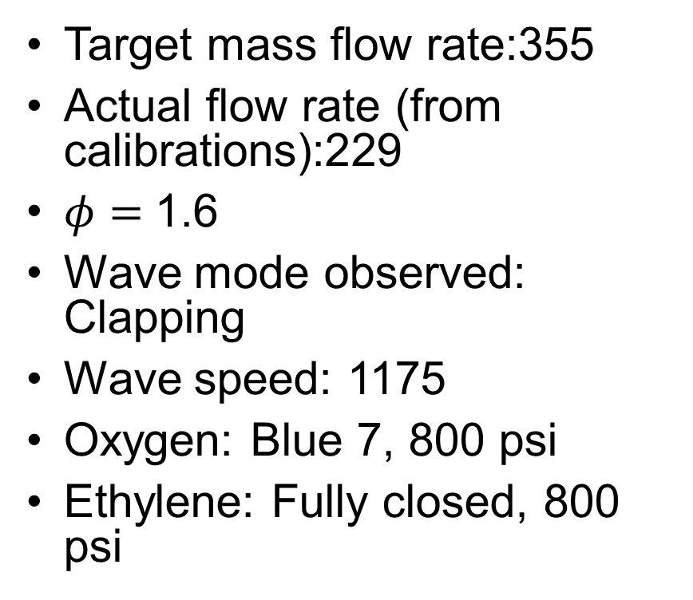
Shot 106
Target mass flow rate:355
Actual flow rate (from calibrations):229
$φ=$1.6
Wave mode observed: Clapping
Wave speed: 1175
Oxygen: Blue 7, 800 psi
Ethylene: Fully closed, 800 psi

Slide 3
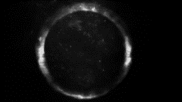
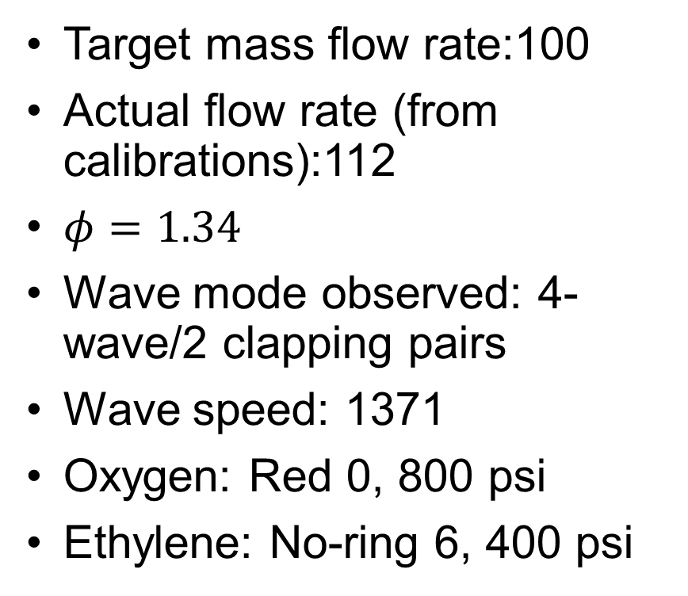
Shot 111
Target mass flow rate:100
Actual flow rate (from calibrations):112
$φ=1.34$
Wave mode observed: 4-wave/2 clapping pairs
Wave speed: 1371
Oxygen: Red 0, 800 psi
Ethylene: No-ring 6, 400 psi

Slide 4
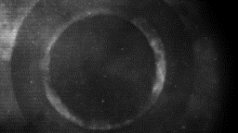
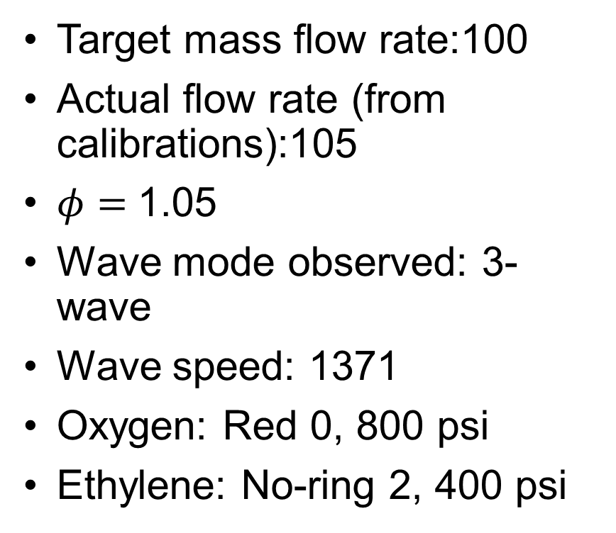
Shot 113
Target mass flow rate:100
Actual flow rate (from calibrations):105
$φ=$1.05
Wave mode observed: 3-wave
Wave speed: 1371
Oxygen: Red 0, 800 psi
Ethylene: No-ring 2, 400 psi

Slide 5
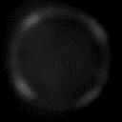
Shot 120 (Concordia facility)
Target mass flow rate:200
Actual flow rate (from calibrations):192
Wave mode observed: 4 clapping pairs

Slide 6

Shot 122 (Concordia facility)
Target mass flow rate:200
Actual flow rate (from calibrations):192
Wave mode observed: 3 clapping pairs

